Slide 1
PNJ - CCIT FTUI 2023
SIMPLE MOVIE STREAMING WEBSITE WITH JAVA
GROUP 9 - 2SE1

Slide 2
GROUP 9
Aditya Farras Zaky Firmansyah
Aurio Hendrianoko Rajaa
Daffa Rifqi Nugroho

Slide 3
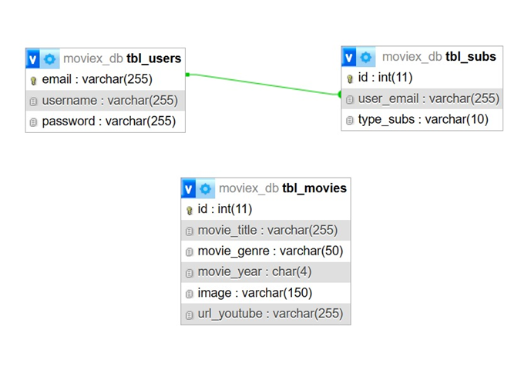
DATABASE DIAGRAM

Slide 4

LANDING PAGE
In this landing page, we give user some sort of information about our website and a login button that will prompt the user into login form.

Slide 5
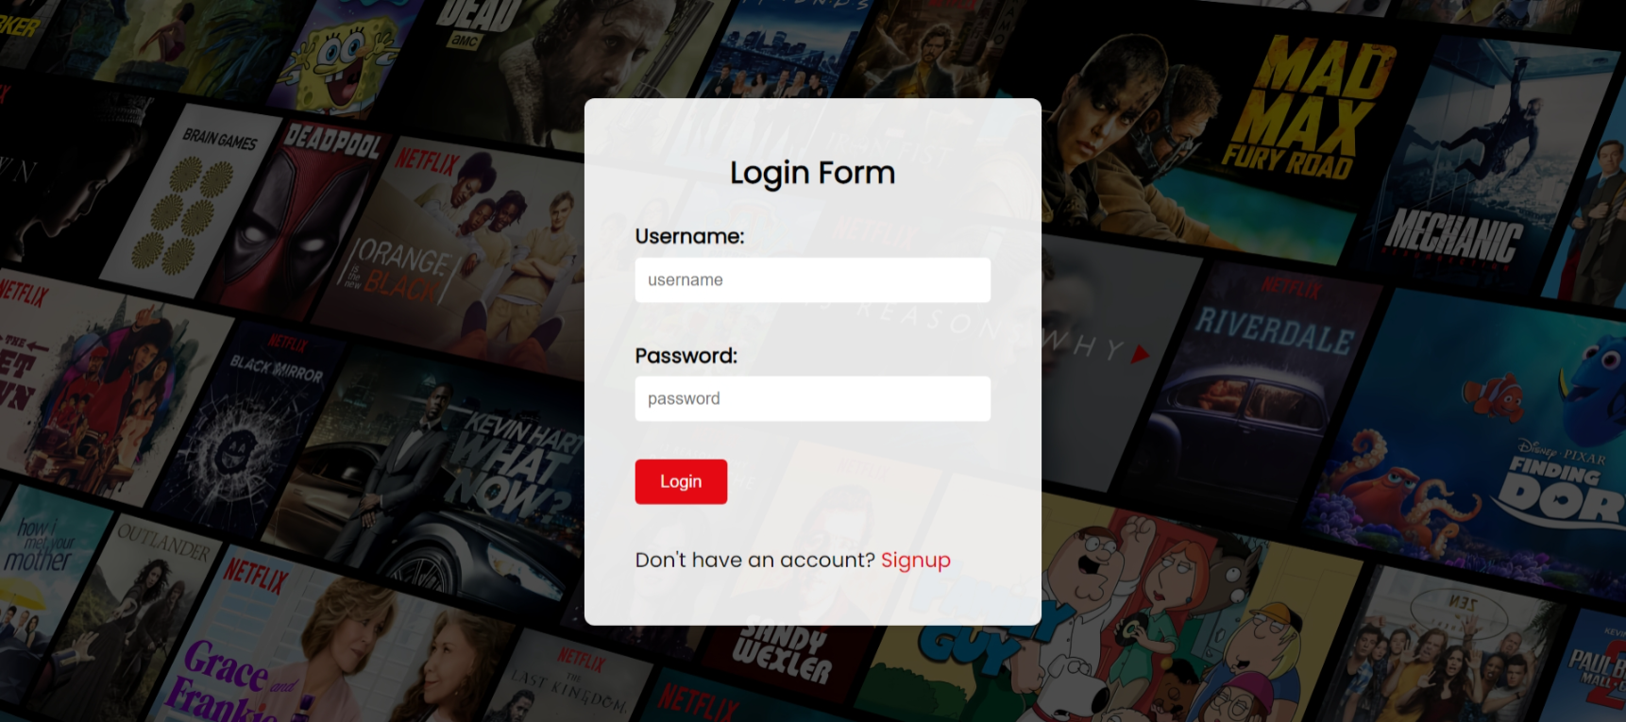
LOGIN
This is a simple login form that will read the user information data.

Slide 6
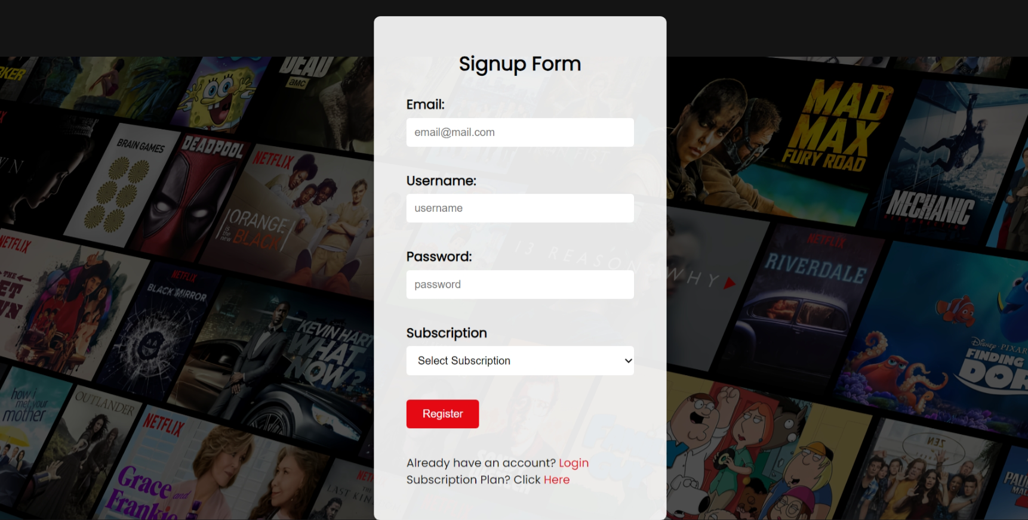
SIGN UP
In this simple sign up, we ask user to input their data to create an account.

Slide 7
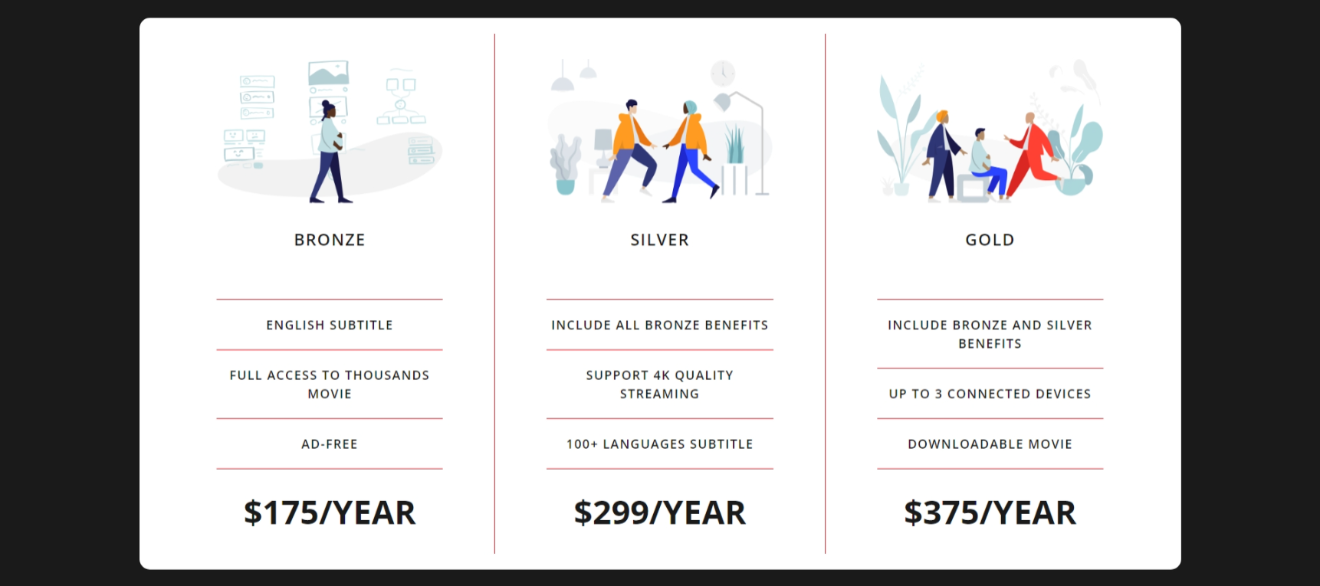
SUBSCRIPTION DETAIL
This is a subscription plan if the user want to see the detail of each subscription.

Slide 8
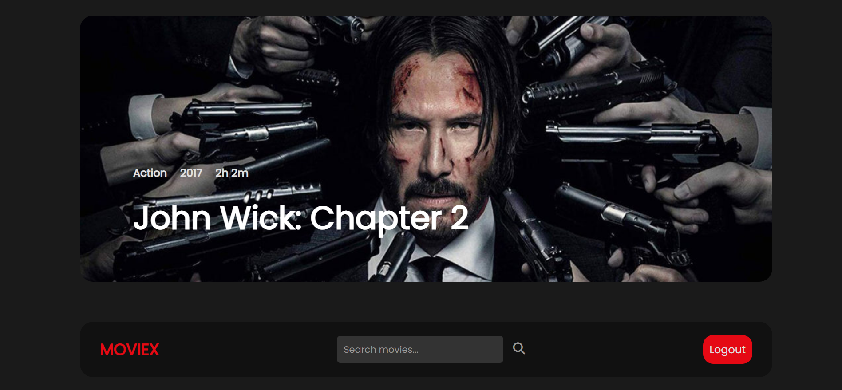
HOME PAGE

Slide 9
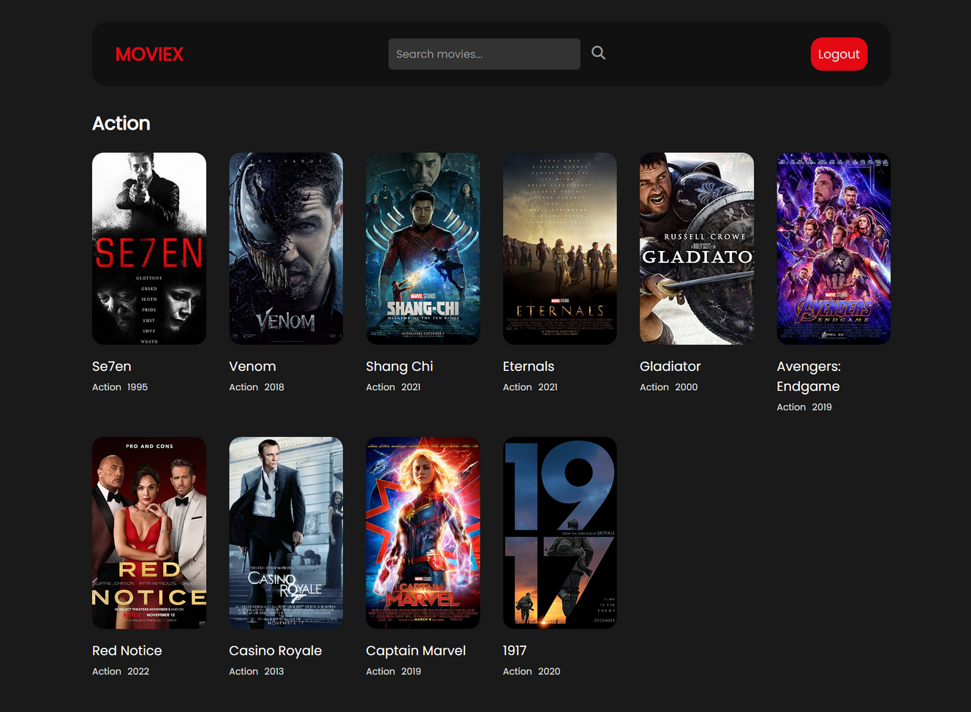
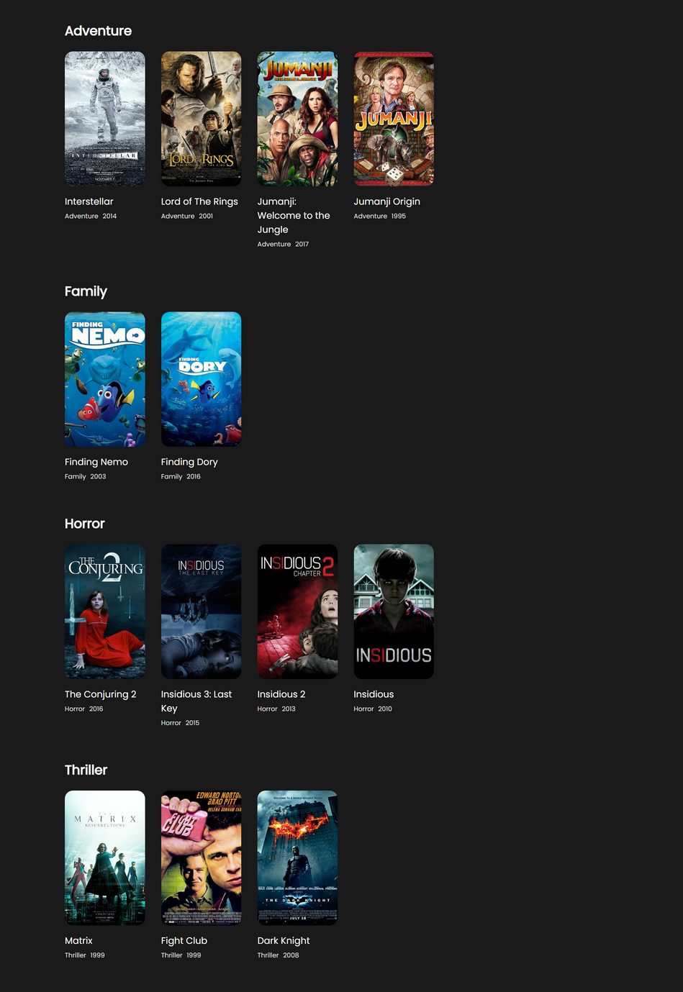
HOME PAGE

Slide 10
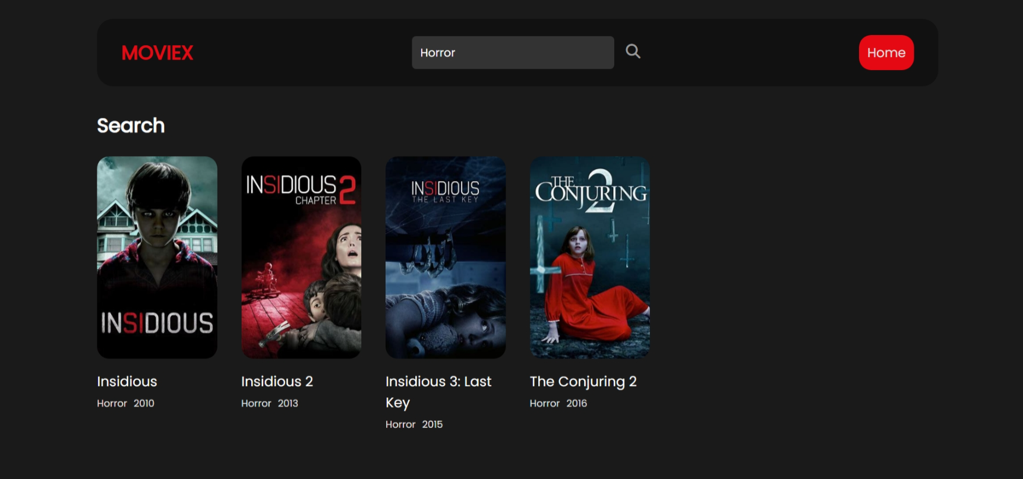
SEARCH BUTTON

Slide 11
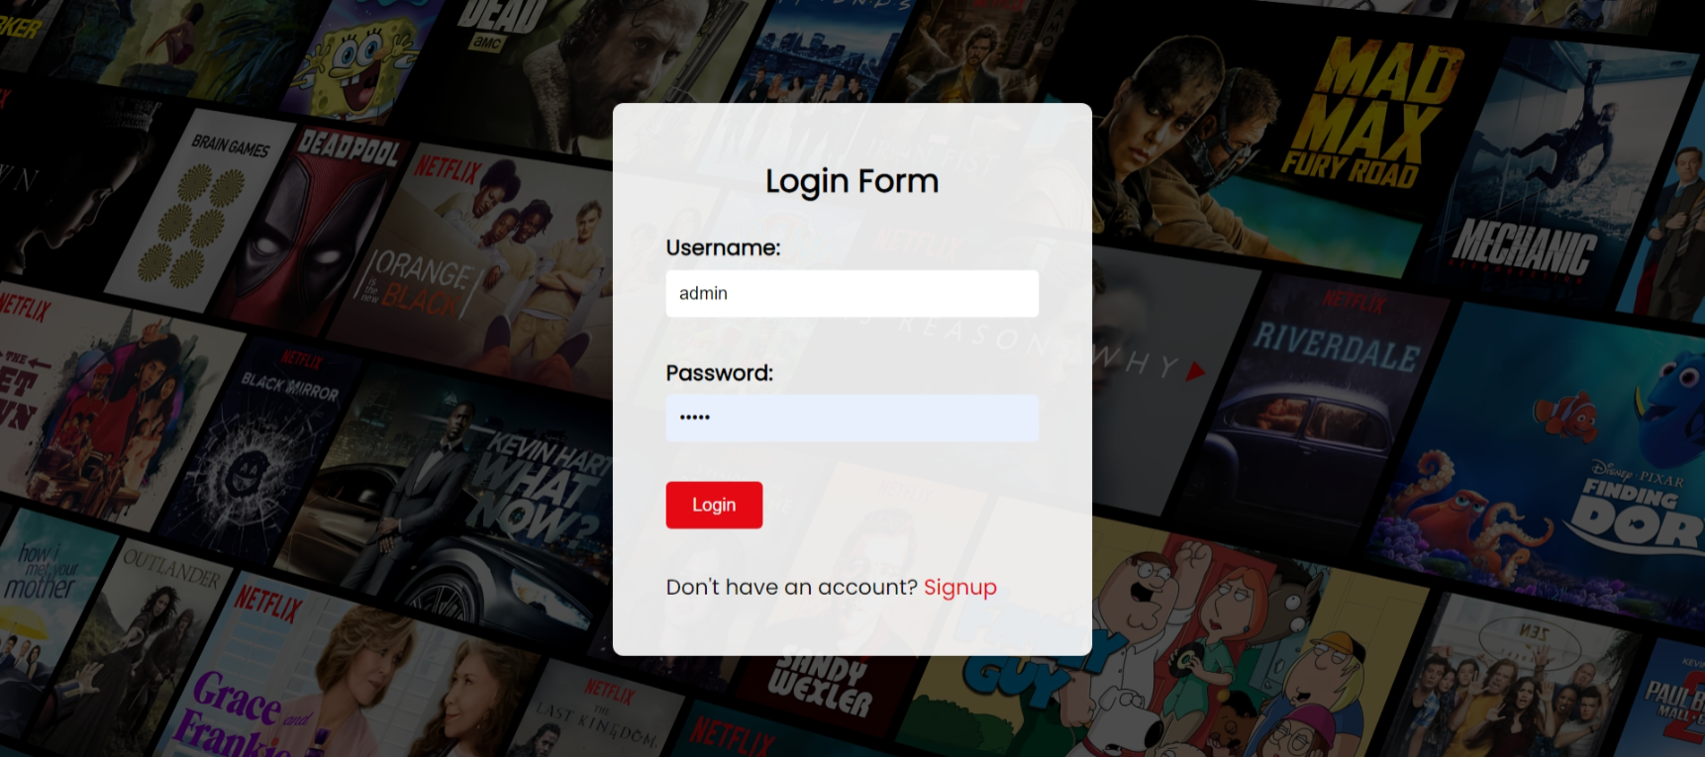
ADMIN LOGIN
Admin can login through the user form with the specified username and password format

Slide 12
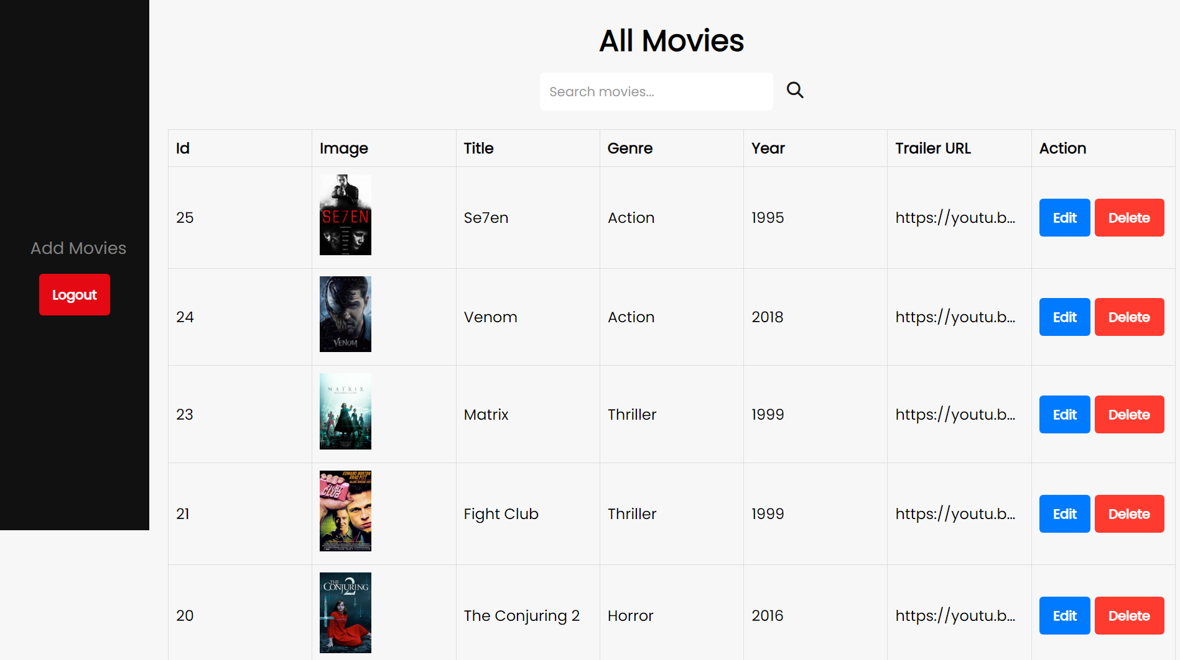
ADMIN PAGE
On the admin page display, admin can add, edit, search and upload movies

Slide 13
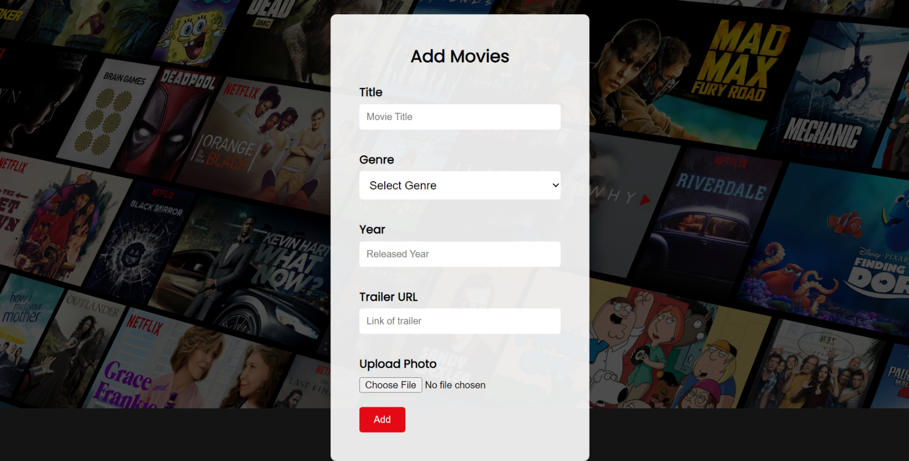
ADMIN ADD MOVIES
Admin can add Movies by Tittle, genre, etc. and the movie will save on database

Slide 14
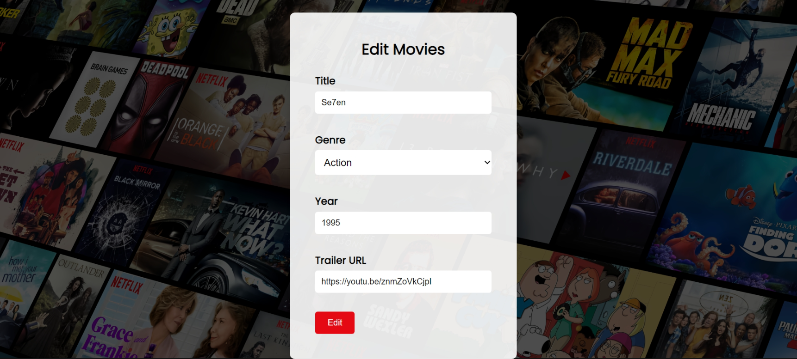
ADMIN EDIT MOVIES
On the admin page edit, admin can edit the title, genre, year and trailer if the movie doesn’t match each other

Slide 15
THANKS!

